Slide 1
STAT 390: DATA SCIENCE CAPSTONE
Small Patch Explanation
Mar 18, 2025
-
Lainey Neild

Slide 2
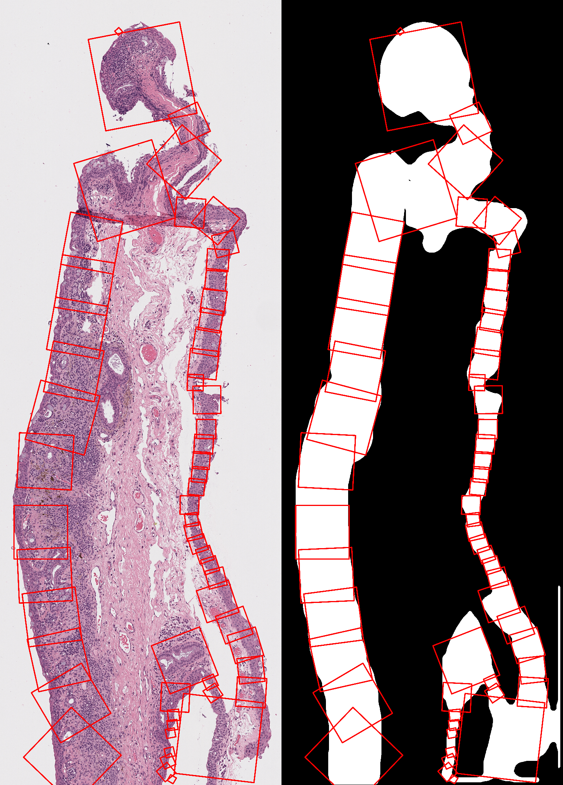
Case 57 H&E Match 1

Slide 3
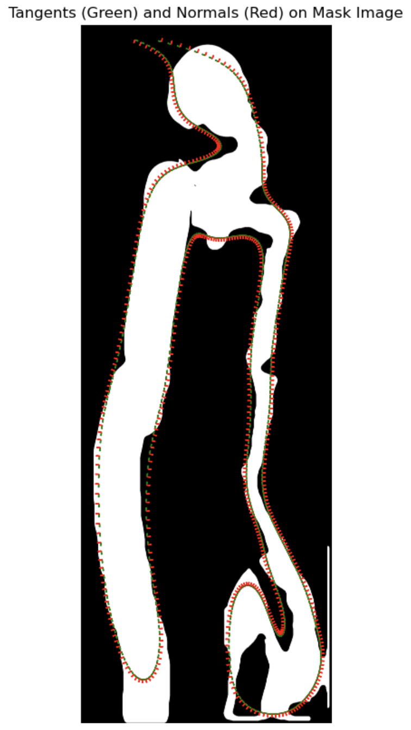
Tangent and Normal
Used Alex’s code to plot tangents and normals
At the place of the tiny patch, we see the tangents and normals go abnormal
Possible reasoning: from soothing factor

Slide 4
STAT 390: DATA SCIENCE CAPSTONE
THANK
YOU
Mar 18, 2025
-
Lainey Neild

